Slide 1
Lecture # 05
Urban Design Process

Slide 2
URBAN DESIGN PROCESS
Urban design is preoccupied with physical form and functional quality of the city.
In terms of approach, it can be viewed as pure technique and/or city building process among various actors
The nature of objectives will depend on the context and scale/level of concern
Thus, at one extreme an urban design plan may be specific including construction and financing details (project level); On the other extreme, urban design may be generic; simply entail a set of guidelines or rules, used to formulate a policy that affects the decisions of others

Slide 3
Urban Design as Technique
I. Formal /Linear Process
This is a logical process, through spatial and formal means, that entails the following main stages:
Problem identification
Goal and Objective-setting
Situational analysis
Synthesis
Evaluation
Implementation

Slide 4
Problem identification
What is not right?
What liabilities?
Whose problem?...who is affected?
Why is it a problem?
When is it a problem?
Where?
What does it call for?
In a stable environment, this may seem a straight forward thing….but in a pluralist environment (diverse), there may be contested issues, stakes, and vested interests.

Slide 5
Goal and Objective-setting
Goals are fairly loose statements of principle that establish a direction, and would hardly provide measurable variables for gauging success.
Objectives are translations of goals into something that is achievable; hence their statement is more programmatic and measurable.
Urban design goals and objectives can occur at any scale of urban design (macro to micro). An urban design scheme devoid of clear goals and objectives can easily be dismissed.
In contemporary societies, change is the norm and the goals of individuals and groups are frequently at odds, making it complicated a task to undertake.

Slide 6
Locale/scale | Goal (example) | Objective (example)
Region | To engender a feeling of the countryside into the city | To develop parks along all the waterways that connect developed urban areas and open countryside
City | To maintain the downtown area as a strong metropolitan centre | To create economic incentives for downtown reinvestment
Neighbourhood | To reduce conflicts between residential and industrial land uses | To create visual and acoustical buffers using fencing and landscaping between all residential property that abuts industrial land uses
Block | To maintain the sense of visual enclosure that presently exists on the street | To limit new development to existing building heights and setbacks in conformance with existing street character

Slide 7
Situational analysis
Through inventories and other data collection techniques.
Considerations include land use, population, transportation, natural systems, and topography; the varied character of areas, structure of neighbourhoods, business areas etc.
Central to understanding the structure, organization, and pattern of urban areas
Includes:
  Visual survey;
  Identification of hard and soft areas;
  Functional analysis

Slide 8
Visual survey
Graphic examination of the key physical elements and functional character of an area.
A vocabulary of symbols exist: edge, path, node, landmark, district (after Lynch) that enables an urban designer to characterize, in graphic form, the key elements of the urban fabric.
Visual survey is an urban design tool used to communicate the perceptions of the structure and organization of a city.
Imageability/legibility: A more legible city makes us feel less anxious about finding our way about in the city

Slide 9
Identification of hard and soft areas
“Hard” and “soft” is concerned with “buildable” and “non-buildable” and does not necessarily coincide with “built” and “unbuilt” .
Delineation of the urban fabric into hard and soft areas assists the designer in identification of the parts of the city that can accommodate growth and change, against those that are essentially fixed because they may be occupied by say historic monuments or cemeteries
Thus, a hard area may be a public park near the city’s central business district that, despite the shortage of land, cannot be identified for new construction. On the other hand, a soft area may include neighbourhood or commercial district with an increasing number of vacant buildings or with condemned building stock that gives an opportunity for redevelopment.

Slide 10
Functional analysis
This examines the relationship of activities among the various land uses and how they relate to circulation systems.
This relates closely with the work of land use planners, the difference being that the urban designer carries out such a study into three dimensions.
For instance, increase in building heights will call for widening of streets to accommodate both motorized and pedestrian traffic.

Slide 11
Synthesis
Data collected and the analysis of the problem are translated into design proposals for action
Design concepts that reflect an understanding of the constraints of the problem and propose optimum solutions, based on tradeoffs such as between motor traffic and pedestrians
Main activities include:
    Evolution of concepts for development
    Development of schematic design
    Preliminary Designs

Slide 12
Evaluation
Based on two main criteria:
  How well the solutions fit the problem?
  How readily the proposals can be implemented?
  Thus, evaluation may examine:
    ability to meet objectives
    ability to gain public acceptance
    meeting financial and technical demands

Slide 13
Implementation
Devising the actual strategies for financing and construction.
Implementation relies on two main tools:
  Land use controls: include the traditional/Euclidean zoning ordinance, Planned Unit Development, Incentive/Bonus zoning, and Transfer of Development Rights
  Capital expenditures: these shape the pattern of land use by altering land values through the provision of access and utilities.
In this age of participation, successful implementation of urban design projects will rely on both capital expenditures and eminent domain (popularity).

Slide 14
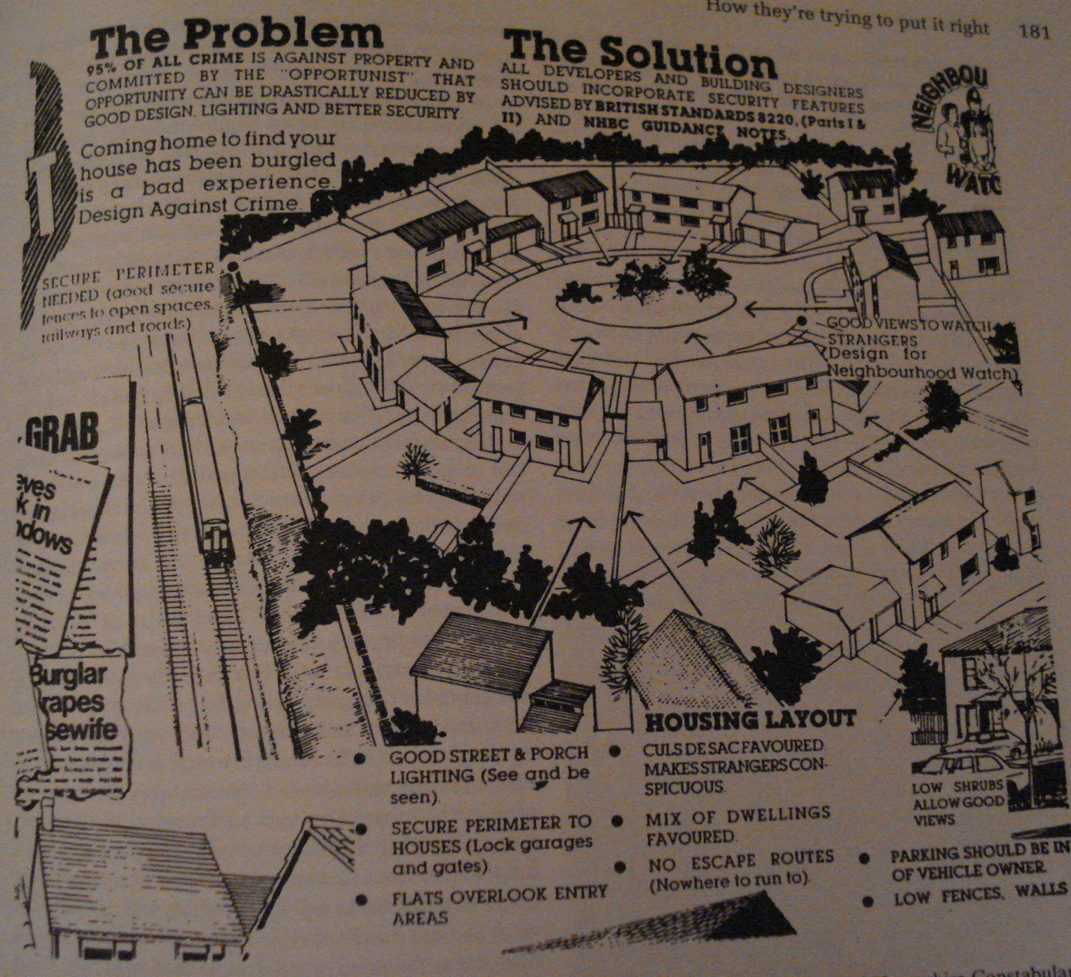
Making a Visual Survey

Slide 15
A visual survey is an examination of the form, appearance, and composition of a city…an evaluation of its assets (to be protected) and liabilities (to be corrected).
As an analysis of a city, its objectives are twofold:
  To establish the relationship between spatial components as well as assessment of their condition
  To determine where the area investigated needs improvement /reshaping/remodelling.
A visual survey can be made at different urban scales: macro to micro

Slide 16
A visual survey calls for a descriptive vocabulary for identification and relation of spatial elements in order to understand the form, function, and consequent appearance of given space.
A good survey generates ideas for action: areas of improvement, correction or total replacement.

Slide 17
Components of a visual survey
Image of the city
Landform and Nature
Local Climate
Shape of urban form
Size and Density
Pattern, Grain, and Texture
Urban Spaces and Open Spaces
Routes of movement
Districts/Enclaves/Sectors
Activity structure
Orientation
Details
Pedestrian areas
Vistas and skylines
Non-physical Aspects
Problem Areas

Slide 18
Image of the city
(paths, districts, edges, landmarks, nodes)
  The mental picture people extract from the physical reality of the city
    a picture of parts of the city in physical relationship to each other
    Picture of the most salient features of a city’s form
    Skeletal elements of city form

Slide 19
Landform and Nature
Landform:
Every city is built on land
Includes topography and landscape character…form of terrain (flat, rolling, hilly etc)
Prominent landscape features should be noted (cliffs, ranges, mountain peaks, rivers, lakes, etc
Type and character of greenery, including its seasonal changes

Slide 20
Nature: Considerations,
Character of surrounding landscape that built form will respond to functionally and aesthetically
Degree to which built form will enhance nature
Natural areas to be left intact to complement urban form

Slide 21
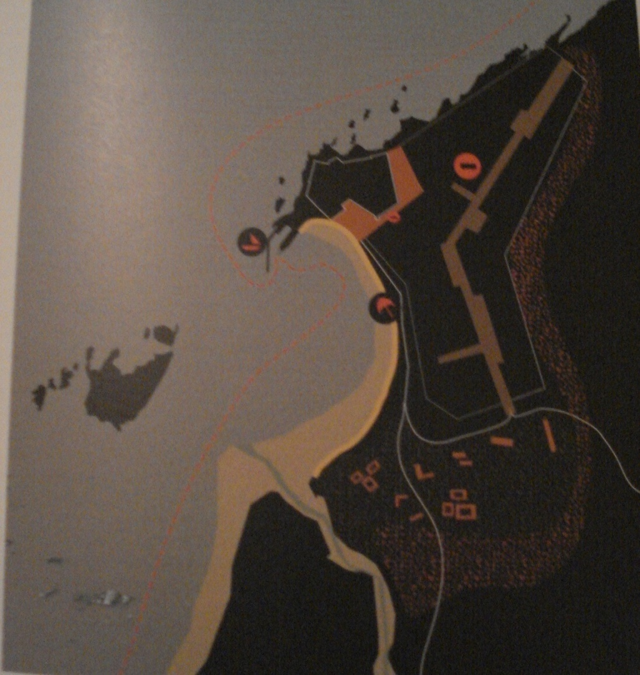
Shape of urban form
Characteristics and objectives of various shapes; pros and cons.

Slide 22
Size and Density
Size: physical extent; no. of inhabitants
Density: population density; unit (dwellings) density; amount of building floor area in a given section of the city (floor area index); automobile density
Relationship of size and density influences the population distribution and urban massing

Slide 23
Local Climate
Temperatures – implications of seasonal temperatures and humidity, averages and extremes, comfort zones and periods, amelioration of extremes and discomfort
Light – implications of clear and cloudy days
Precipitation – rain and snow
Sun – angles of the sun (solar altitude) at different seasons affects viewing conditions…long and short sunny days
Winds –direction and intensity of seasonal winds; cold and hot winds

Slide 24
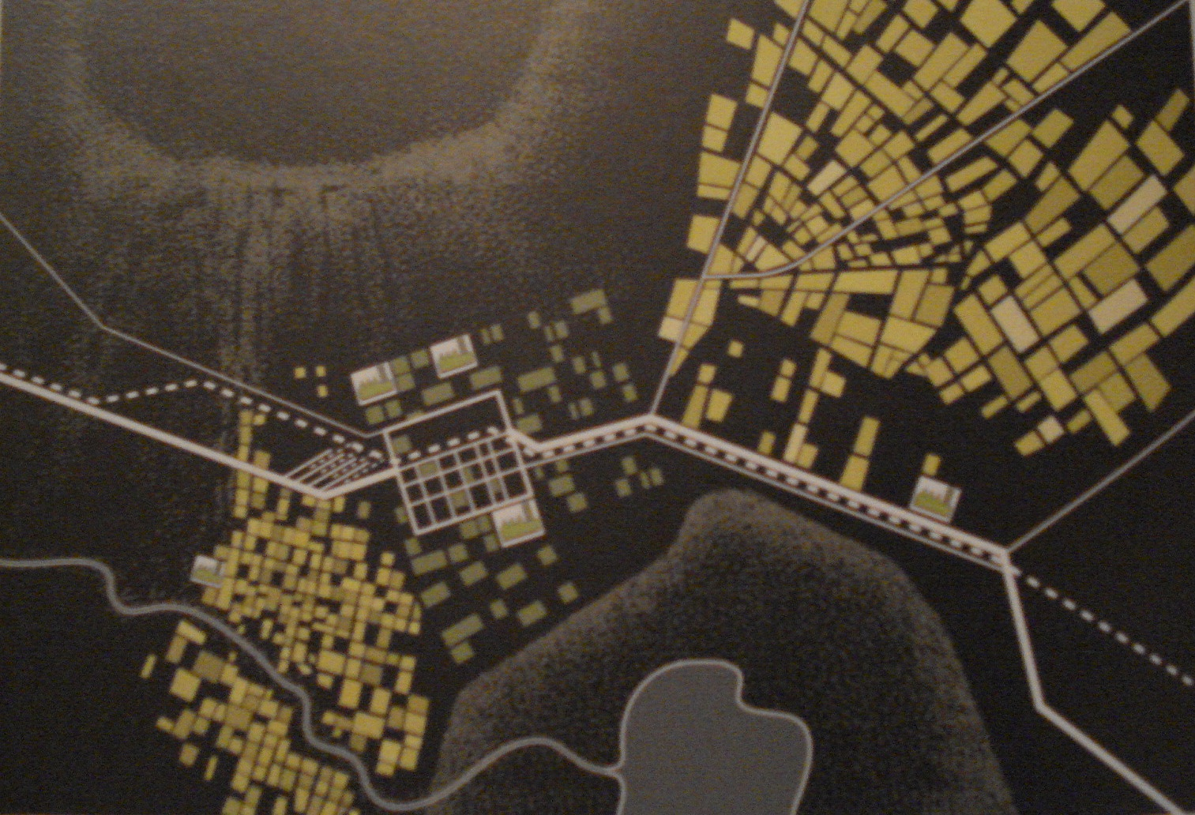
Pattern, Grain and Texture
Pattern: the underlying geometry of city form…mostly define by block and street layouts
Grain: degree of fineness or courseness in an urban area
Texture: the degree of mixture of fine and course elements of urban form (even vs uneven)

Slide 25
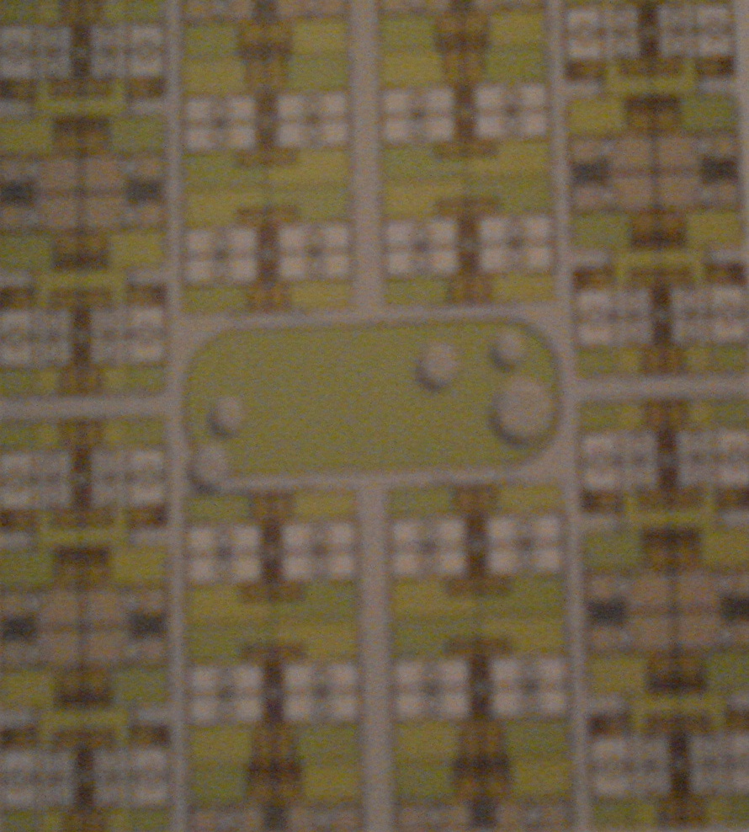
Urban Spaces and Open Spaces
Voids within the city
Urban spaces: formal…usually modelled by building facades and the city’s floor
Open spaces: natural, representing nature in the city

Slide 26
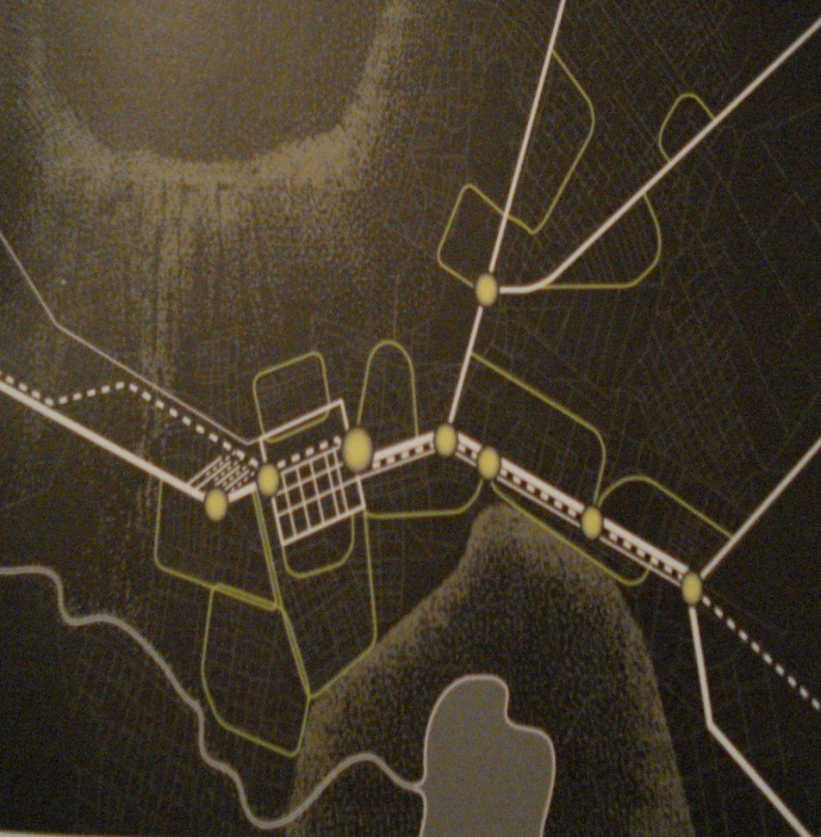
Routes of movement
Principal determinants of urban form:
Routes affect the appearance of the landscape through which they pass as well as the architecture and form of cities they serve.

Slide 27
Routes of movement (cont’d)
Clarity of routes in form and direction is a design concern
Routes should have physical relationships and help define areas they serve instead of just slashing through them, causing blight and disintegration
Routes should artfully traverse the landscape, revealing its strong features.
Approach routes present cities to us and enable us to fond our destination…thus they both inform and conduct us.
Surface arteries are major routes through the city…high volume traffic
Local streets carry a mixture of people and vehicles; through traffic not desirable.

Slide 28
Evaluation of streets
How streets tie together into the expressway pattern
Clarity of form
Relationship to cityscape
How they shape building sites
How they pass through existing districts
Vehicular versus pedestrian traffic…any conflicts?...or complementary?
Crossing levels…specific or not defined: stoplights, grade separation
Through versus local traffic
Scale…how size of streets relates to size of the districts they serve

Slide 29
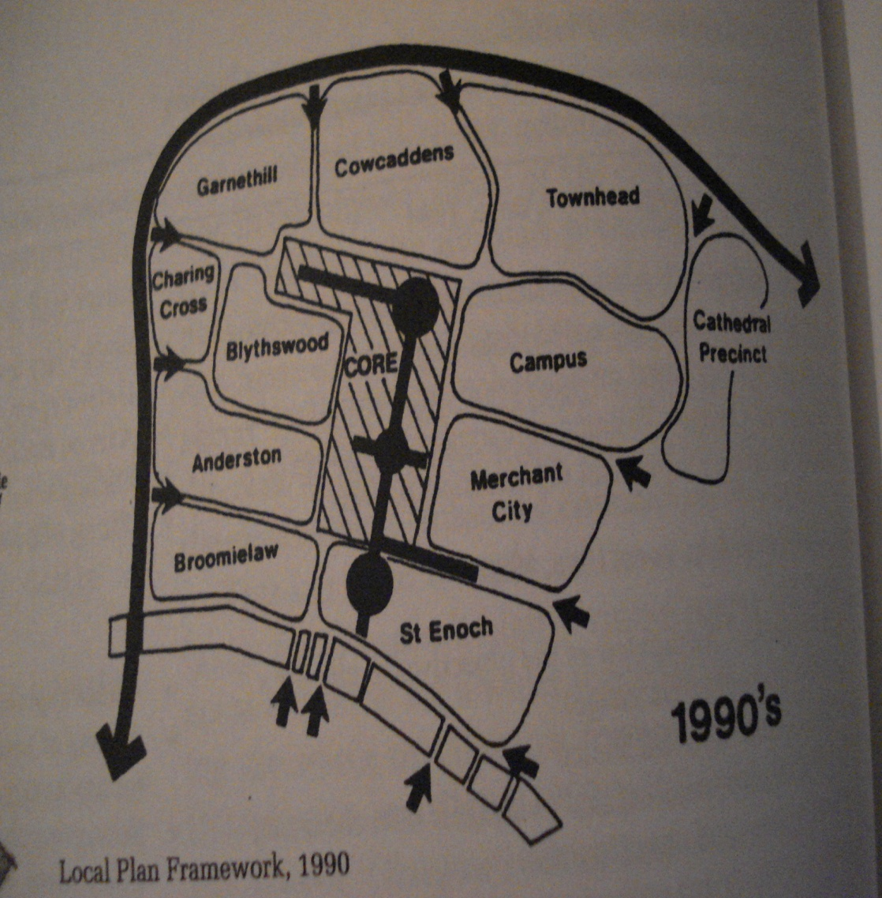
Districts of a city
These are: areas/precincts/quarters/sectors/enclaves of the city
Often have dominant, distinctive, and pervasive characteristic features
The city is an arrangement of these.

Slide 30
Districts (cont’d)
Districts may be distinct, overlapping, uniform, complex.
Two data categories to assess:
    Physical form
    Visible activity
We assess:
- Components, appearance, activity, threats, emergence, relations
Anatomy of a district: form, activity, features, paths, centres, intrusions, change, improvement

Slide 31
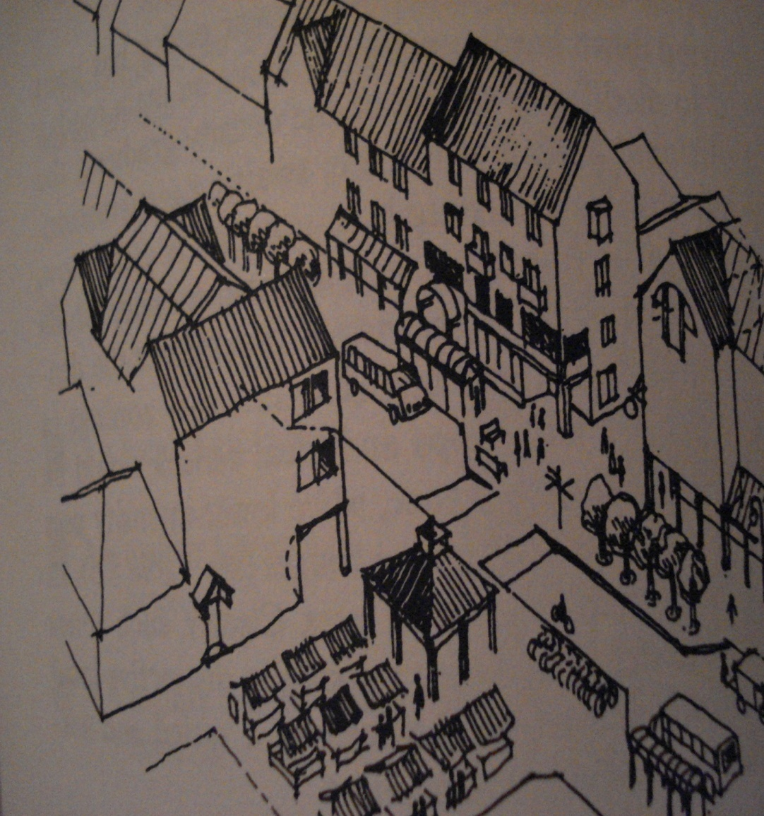
Activity structure
This captures certain areas of the city with characteristic functions…living, leisure, learning etc
Activity structure will be affected by density, topography, transportation routes.

Slide 32
Orientation
This is the logical articulation of the arrangement of a city’s anatomy expressed visually
A city lacking orientation is confusing and may cause confusion, anxiety and feeling of getting lost
Landmarks are the prime aids in orientation

Slide 33
Details
These include objects of various types for direct/indirect or conscious/unconscious use: signs, benches, waste bims, street lamps, e.t.c
The quality of detail should be informed by the nature of audience targeted.

Slide 34
Pedestrian Areas
These address walking as a prime mode of transportation (communication and inter-movement.
These should be creatively integrated with motorized transportation.
Traffic calming is a specific concern in design of pedestrian areas…low speeds, minimal through traffic, one way streets etc
Adequacy of pavements: widths, paving, condition of repair, protection from elements of weather, furniture and fittings
Intersections and crosspoints: impact on flow rates, continuity, and sequence

Slide 35
Vistas and Skylines
Vistas are strong visual links
May serve approach or departure purposes of urban areas…i.e views into and out of a city.
Some views are gazetted and legally protected as urban assets
Vistas could be complemented by buildings (ref. use of axis in renaissance; civic design of Nairobi)

Slide 36
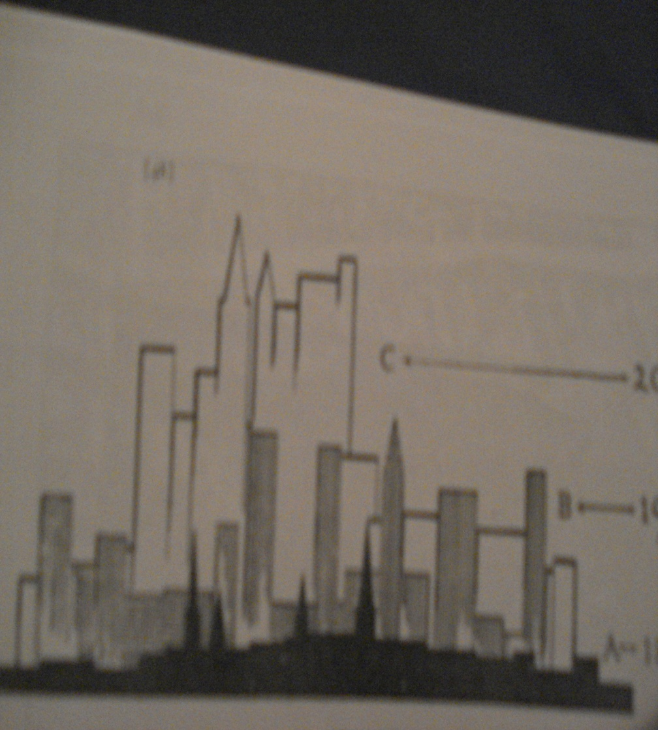
Skylines
Skyline refers to the (3-dimensional) compositional and sequential character of urban spaces and buildings
It is a representation of a city’s facts of life and embraces the maximum amount of urban form in a single visual output.
Every building with a potential to alter a city’s skyline should be studied carefully (ref. CBD skyline exercise, B.A I)

Slide 37
Non-physical Aspects
These are non-architectural aspects of urban character that are still a large part of a city’s image and personality
Historical aspects, public ceremonies and events

Slide 38
Problem Areas
These have to be mapped out during visual survey.
The problem map represents urban design diagnosis of problems.
It may include: points of conflict (in land use, circulation etc); areas with little or no sense of orientation; non-descript or grey areas; ugliness; communities lacking form and definition; areas with confusing signs; areas of decay and crime; confusing circulation; incomplete routes etc.

Slide 39
Recording Results of a Visual Survey
Visual surveys are commonly recorded as simple maps accompanied by sketches, photographs, and descriptive notes.
The sketches, photographs, and descriptive notes can be attached to the map into an aggregate drawing or report

Slide 40
Visual Survey Recording Checklist
A set of maps might include the following:
Topography
Microclimate – sun , wind, storm directions etc
Shape
Patterns, textures, and grains
Routes
Districts
Landmarks and nodes
Open Spaces
Vistas
Magnets, generators, and linkages

Slide 41
Visual Survey Recording Checklist
Special activity centres and overall activity structure
Hubs of intense visual experience
Strong and weak areas of orientation
Sign areas
Points of conflict
Historic or special districts
Community structure
Areas of preservation, moderate remodelling, and complete overhaul
Places needing clarifying design elements
Sketch maps of prominent urban features and form

Slide 42
Urban Design as Process
Entails City Building action among various parties
Negotiation – by political-economic means
Sectoral issues of importance
Institutional Design; Community Activism; eminent domain and their role in design
Linking ideas to action (Urban trialogues); Visions-Strategic urban projects-Co-production (collective participation of actors)
Leverage for resources; political processes; community mobilization and involvement

Slide 43
Urban design charters: commit Government agencies to achieve good urban design when managing public places or creating the public buildings and infrastructure that contribute to the qualities of our streets, squares, parks and waterfronts.
II. Non-Formal/Non-linear Design Approach

Slide 44
Implementation models
(urban design as process)

Slide 45
`
Functional Analysis (software):
Employment/Occupational structures;
Demographic structure;
Neighbourhood Lifestyles/perceptions;
Procurement/ownership/ use patterns
Technology &materials;
Amenity and services;
Symbolic & aesthetic order;
Socio-political order:
Policy, institutions, and, governance.
Character
(Socio-spatial)
Physical Analysis (hardware):
  Morphology
Building typology & construction systems
  Image and public realm
Objects & Aesthetic detail
Infrastructural installations
Nature, Intensity, Location, and impact of Modernity
Community perception of Modernity
Projected Areas of (traditional-modern) Conflict and Congruence
Adaptability of traditional to modern functions

